Slide 1
Tuples & Dictionaries
Notes:
Hello, everyone! If you have been keeping up with all the lessons so far, you are now pretty proficient with the fundamentals of programming in general, and programming with Python in particular. You know about data types, variables, expressions and operations. You also know about sequential execution, selection using if-else, loops using while and for, and how to write functions. Most of these principles are not specific to Python and can be applied to whatever programming language you happen to be using.
In this lesson, we will talk about two built-in structures that are specific to Python. You are already familiar with how Python handles lists and strings. Today, we will examine two other structures, namely tuples and dictionaries.

Slide 2
Objectives
At the end of this lecture, you will learn:
How to create and use Tuples
How to create and use Dictionaries
Notes:
You already understand how to use a list in Python. You can store multiple pieces of data in a list and access them using the square bracket operator. You xan alsoadd and remove items from a list, and use a for loop to traverse a list. So a list is pretty flexible and is one of the most common ways to organize multiple items together in Python. On the other hand, sometimes it is better to use some other structure. In this lesson, we cover tuples and dictionaries, which are two other ways to organize multiple items in Python.

Slide 3
Tuple
Notes:
We begin with the tuple, which is a reasonably simple structure. It can be pronounced “tupple” or “toople”. Either will work. Or eye-ther. English is weird.

Slide 4
What is Tuple
A tuple is a sequence of immutable Python objects. Tuples are sequences, just like lists
Immutable means a python object in a tuple cannot be changed, updated or modified
Why use tuples if they are immutable?
They provide “read-only” access to the data values, preventing accidental modification
They are faster than lists
The operations relating to Tuples are similar to Lists
Notes:
So what is a tuple? Honestly, tuples are very similar to lists except that lists are mutable whereas tuples are immutable. That’s just a fancy way of saying that the items in a list can be modified, but items in a tuple cannot. What this means is that there are some things that you can do to a list that you can’t do to a tuple.
If that’s the case, why would we use a tuple instead of list? There are a couple of reasons. Sometimes you don’t want the data to be modified. If the values in the collection are not supposed to be changed, then you should use a tuple instead of a list to prevent accidental modification. Also, program execution is generally faster when using a tuple compared to an equivalent list. This is probably not going to be noticeable when the list or tuple is small, but could be significant when handling large amounts of data.
In other words, if the items in the structure won’t change, use a tuple instead of a list.

Slide 5
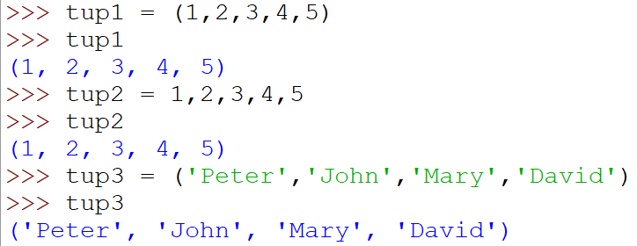
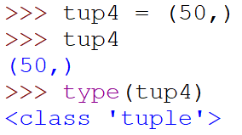
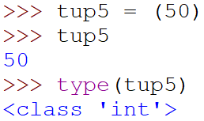
Creating a Tuple
Creating a tuple uses parentheses ( ), whereas list uses square brackets [ ]
Create a tuple with 1 value (must include a comma)
Notes:
So how do we create a tuple in Python? It’s pretty much the same as for a list, except that while we use square brackets for a list, we use round brackets (also called parentheses) for a tuple.
Well, that’s the simple explanation. The full story is a bit more subtle, because you can even define a tuple without brackets, like tup2 in the given example.
One last detail: if you are creating a tuple with 1 value in it, you need to include a comma as shown here for tup4. Otherwise, Python will not know that you intend to create a tuple, so tup5 is actually the integer 50, not the tuple containing the integer 50.

Slide 6
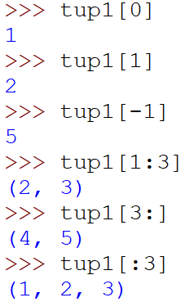


Accessing Values in Tuple
Accessing an element in tuple is exactly same as in list.
Use bracket operator [ ]
Notes:
Other than that, most of what you learned about lists applies to tuples. To access an element in a tuple, you use the same square bracket operator. So you can retrieve an element by using a single index, use a negative index to count from the back, or slice up a tuple using a colon in the square brackets.

Slide 7
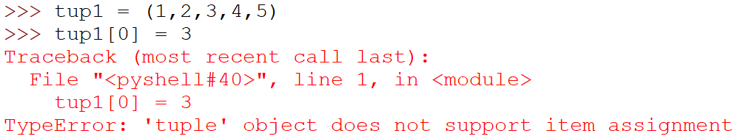
Updating Values in Tuple
Tuples are immutable or unchangeable.
Cannot update or change the values in tuple
Tuple does not have these methods as list:
append() | clear() | copy() | extend() | insert()
pop() | remove() | reverse() | sort()
Notes:
How about updating the values? You can’t. Don’t try. Python will scold you with an error message, because like we said, tuples are immutable.
Specifically, here is a list of functions that are available in a list, but they are not available in a tuple. These are all functions that change the list in some way, but tuples don’t allow that. Tuples are irritatingly stubborn that way.

Slide 8
Methods in Tuple
Methods | Description | Example letters is the tuple ('a', 'b', 'a', 'b’)
index(x) | Return the index in the tuple of the first item whose value is x. Error occurs if x is not in the tuple. | letters.index('a') ➔ 0 letters.index('c') ValueError: tuple.index(x): x is not in tuple
count(x) | Return the number of times x appears in the tuple. | letters.count('a') ➔ 2 letters.count(‘c') ➔ 0
Notes:
On the other hand, the list functions that do not make any changes are also available for tuples. You can use the index function to find the position of the first instance of the argument in the tuple, but be aware that a ValueError will be raised if the item cannot be found. You can also count the number of times the item appears in the tuple using the count function.

Slide 9
Basic Tuple Operations
Python Expression | Results | Description
len((1,2,3)) | 3 | Length
(1, 2, 3) + (4, 5, 6) | (1, 2, 3, 4, 5, 6) | Concatenation
(1, 2) * 3 | (1, 2, 1, 2, 1, 2) | Repetition
3 in (1, 2, 3) | True | Membership
for x in (1, 2, 3): print(x, end=' ') | 1 2 3 | Iteration
Notes:
Here are a few more things you can do with a tuple.
The len function works with a tuple just like with lists and strings, giving the number of items in the tuple. You can concatenate two tuples using the plus sign, and you can even create a repeated tuple using the asterisk sign combined with an integer. Use the “in” operator to find out if an item is in a tuple. And yes, you can use a for loop to iterate through a tuple, just like for a list.
So that’s it for a tuple. Easy, no? In fact, it’s so easy that we’re not even going to have an activity on it. You’re welcome.

Slide 10
Dictionary
Notes:
Instead, we are going to go straight to talking about the Dictionary structure, which is honestly pretty darn cool. You know how for a list, its indexes are sequential, going from 0, 1, 2 and so on? That’s pretty useful, but for dictionaries, their indexes can be pretty much anything. It’s like if you were looking for the definition of a word in dictionary dot com, all you need to do is type the word into the text box and dictionary dot com will retrieve the definition for you. That’s what a dictionary does – it retrieves the information stored at a particular index, and that index could be almost anything, not just an integer.

Slide 11
What is Dictionary
index
list friends
index
list phones
A dictionary is like a list, except
Indices (keys) can be almost any type
Items are unordered
A mapping between a set of indices (keys) and a set of values
key-value pair
0 →
'Peter'
0 →
'98765432'
1 →
'David'
1 →
'89776671'
2 →
'Vincent'
2 →
'88123455'
3 →
'Hafiz'
3 →
'91238980'
4 →
'Janet'
4 →
'92636318'
5 →
….
5 →
….
'Hafiz' → '91238980'
'David' → '89776671'
'Vincent' → '88123455'
'Peter' → '98765432'
'Janet' → '92636318'
dictionary phoneBook
key …. value
Notes:
Suppose we wanted to store the phone numbers of our friends in a structure. One way we could do this is to maintain two lists. The first list could contain the list of our friends’ names, so in this example, Peter is at index zero, David is at index 1, and so on. Then we have a second list that contains all the phone numbers, and we match the numbers to the index. So since Peter is at index 0, the phone number at index zero is Peter’s number. While this works, it’s pretty clumsy. We have to make sure that the two lists are always synchronized, and in order to find the phone number of a particular person, we will have to look through the friends list, find the index, then go to the corresponding index in the phones list to find the phone number. There has got to be a better way.
And there is. We could instead store the information in a dictionary, which would look something like this. You see that the dictionary contains key-value pairs. In this example, the keys are the friends’ names, and the values are the phone numbers, all neatly placed in a single structure. Also, the entries have no numerical index unlike the lists. And here’s the cool thing. We can just use the person’s name as the index in order to directly retrieve the phone number.
In summary, a dictionary is like a list, except that the indices do not have to be integers starting from zero. They can instead be other types, like strings, floats, tuples, whatever. Also, the items in a dictionary are unordered, so there is no concept of one entry being before or after another. They are just associated with their key.

Slide 12

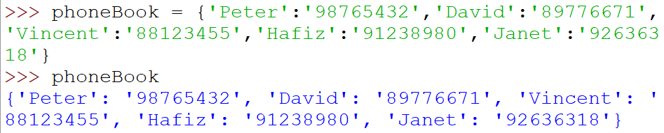
Creating a Dictionary
Enclose items in braces, separate each item by commas, separate the key and value by a colon
The items in the dictionary is unordered
Sequence may be different from the one created
Notes:
OK, so how do you create a dictionary? Well, a list uses square brackets, and a tuple uses round brackets. Since they already chope those, a dictionary uses curly brackets, also called braces. So you would create an empty dictionary like this.
To put stuff into a dictionary, you will need to put in both the key and the value, like in this example. The key is what you search the dictionary for, and the value is the information that you want to retrieve. Each entry in a dictionary is therefore a key-value pair, separated with a colon. Here, Peter is the key, and his phone number is the value. If you have multiple entries, you will separate each entry with a comma, just like for lists and tuples.
It bears repeating that the items in the dictionary are unordered. Even though it looks like Peter is before David in this example, that’s not the case. In fact, when you traverse a dictionary, the sequence of traversal may be different from the order of creation. Essentially, you can never assume a particular sequence of entries in a dictionary.

Slide 13
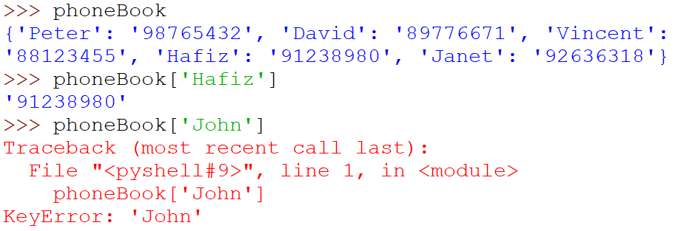
Accessing Values in Dictionary
Use the subscript operator [ ] to obtain the value associated with a key
If the key is not present, an error is raised.
Notes:
Having created a dictionary, how do you access the values stored in it? One way is to use the subscript operator, which is the square bracket that you are familiar with when dealing with lists. You know how for a list, you could use the square bracket to get the value at, say, index 3? For a dictionary, you would use the square bracket to get the value at, say, key ‘Hafiz’ or ‘Peter’. So if the key is a string, you would have a string inside the square brackets.
When using this subscript operator, if the key does not exist, Python will raise a KeyError and crash.

Slide 14
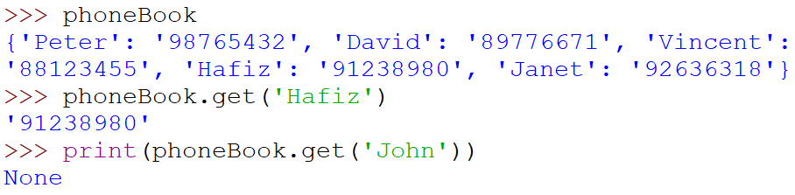
Accessing Values in Dictionary
The get() function can also obtain values associate with a key:
aDictionary.get(aKey)
If the key exists in the dictionary, the associated value is returned.
Otherwise, None is returned.
Notes:
Alternatively, instead of using the subscript operator, you can use the get function. This is almost identical to using square brackets, with one crucial difference: if the key does not exist in the dictionary, it will return None instead of raising a KeyError. Depending on your program, this may be more suitable in order to avoid your program crashing.

Slide 15
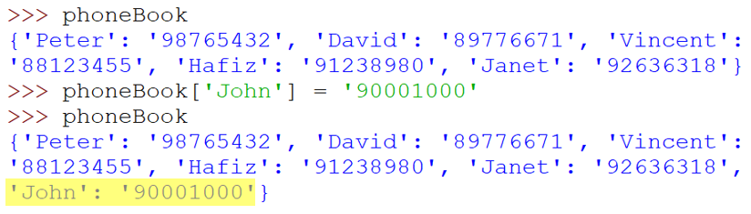
Adding/Replacing item
The subscript operator [ ] can be used to insert a new item or modify an existing item in a dictionary:
aDictionary[aKey] = aValue
If the key does not exist in the dictionary, a new item with the key-value pair is added.
Notes:
To add a new entry into a dictionary, all you need to do is assign the new value using the subscript operator and the equal sign. For example, you might want to add a new entry for John into the phonebook, and this is how you would do it. Pretty simple.

Slide 16
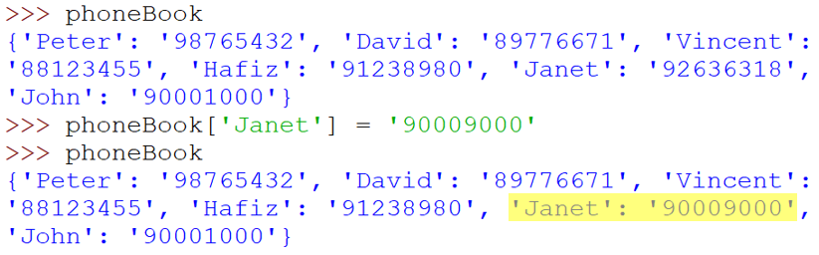
Adding/Replacing item
If the key exists in the dictionary, the original value associated with the key is replaced.
Notes:
You would use the same method to update an existing value in the dictionary. In this example, Janet’s new phone number is updated in the dictionary. Python does not give any warning that you are overwriting an old value, you will have to keep track of that yourself.

Slide 17
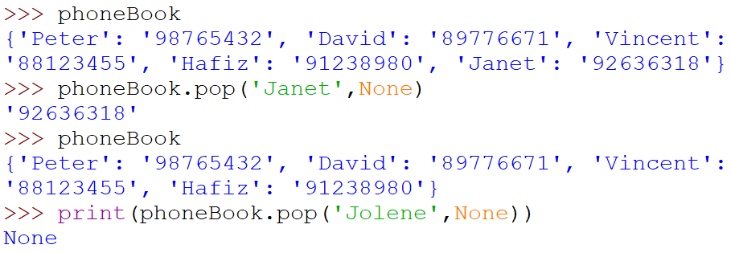
Removing item
The pop() method removes an item with a given key:
aDictionary.pop(aKey[, defaultValue])
If the key exists in the dictionary, it is removed and the associated value is returned.
Otherwise, the default value is returned.
Notes:
If you want to remove an item from the dictionary, you can use the pop() function. The pop function has two parameters, although the second one is optional. The first parameter is the key of the entry to pop, and the second parameter is known as the default value. If the key exists in the dictionary, it will removed and the function will return the corresponding value. So in this example, the entry for Janet is removed, and the corresponding value is returned.
If the key is not found, it will return the default value instead. So since the key ‘Jolene’ is in the dictionary, the specified default value of None is returned.

Slide 18
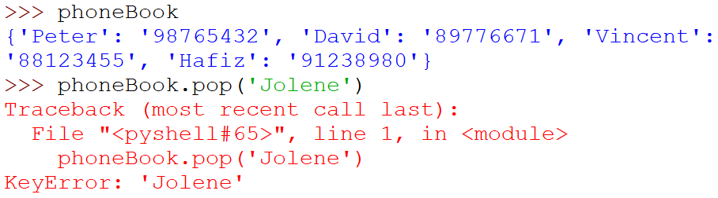
Removing item
If no default value is stated, an error is raised
Notes:
On the other hand, if you do not specify a default value and the key is not found, Python will raise a KeyError. If you don’t want this to happen, make sure you specify a default value.

Slide 19
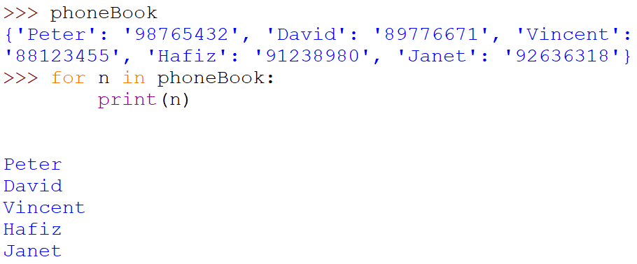
Loop through a Dictionary
Use a for loop to obtain the keys of a dictionary.
Notes:
Next, let’s see how you can iterate through a dictionary. This is slightly more complex than for a list, because each entry consist of two parts – the key and the value.
First, let’s see what happens when you just use a for loop to iterate through the dictionary itself. In this example, we see that the index n takes the values of each key in the dictionary. This is an important concept to remember: when you use a for loop to iterate through a dictionary, you get the keys, NOT the values.

Slide 20
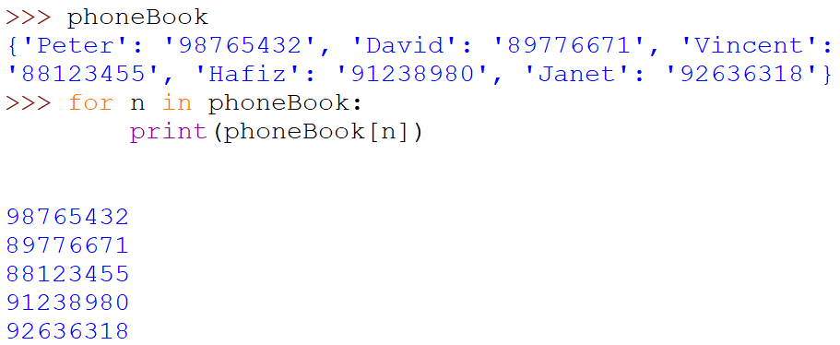
Loop through a Dictionary
Use a for loop to obtain the values of a dictionary
Notes:
OK, so how do you get the values then? Easy. Just use the keys in the subscript operator to get the values, like this.

Slide 21
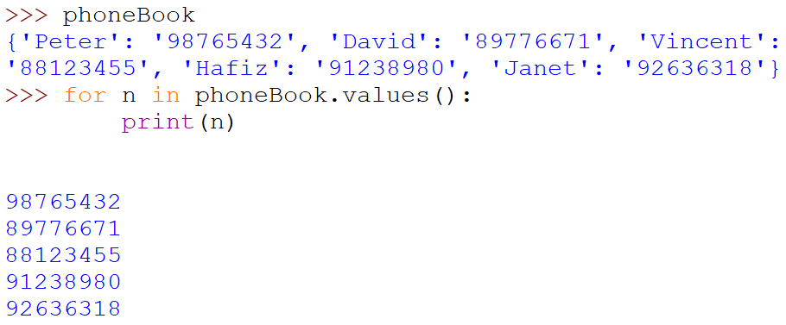
Loop through a Dictionary
Use values() method in a for loop to obtain the values of a dictionary
Notes:
Alternatively, the dictionary provides a function called values() that returns the list of values in the dictionary, and you can use a for loop to iterate through this list as usual. In this case, you will not know what are the keys associated to these values.

Slide 22
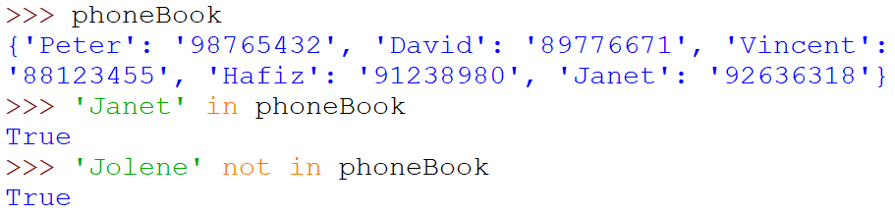
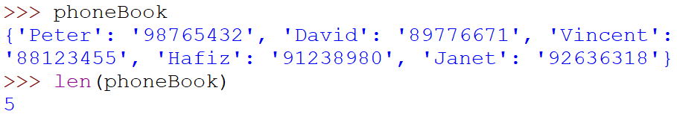
Dictionary Operations
in operator detects the presence of a key in the dictionary
function len() returns the number of items in the dictionary.
Notes:
You can use the in operator to check if a particular key is in the dictionary. So in this example, you can check if Janet or Jolene is in the phonebook. Note that the in operator works on the keys, not the values.
The len() function works exactly the same as for a list - it returns the total number of entries in the dictionary.

Slide 23

Dictionary Functions
Methods | Description
get(key,[default]) | Returns the value for key if key is in the dictionary, else default. If default is not given, it defaults to None, so this method never raises a KeyError.
pop(key,[default]) | If key is in the dictionary, removes it and returns its value, else returns default. If default is not given and key is not in the dictionary, a KeyError is raised.
Notes:
All right, we will finish up by taking a look at the functions provided by the dictionary structure. You have already seen these two functons. The get function is an alternative to using the subscript operator and never raises a KeyError, while the pop function removes an entry from the dictionary.

Slide 24
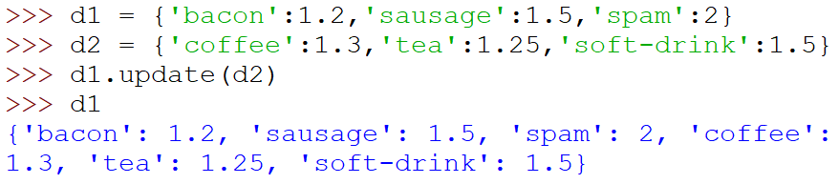
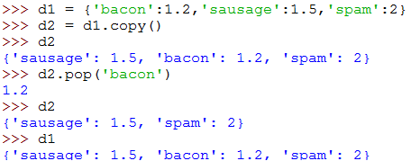
Dictionary Functions
Methods | Description
update([other]) | Update the dictionary with the key-value pairs from other, overwriting existing keys. Returns None.
copy() | Returns a copy of the dictionary.
Notes:
The update() function is useful when you want to combine two dictionaries. It will update the entries in a dictionary with the items from another dictionary. If the key from the other dictionary exists in this dictionary, it will update the value. If the key is not found in this dictionary, then the key and value will be added to this dictionary as a new item.
The copy() function creates a new dictionary with all the items in this dictionary.

Slide 25
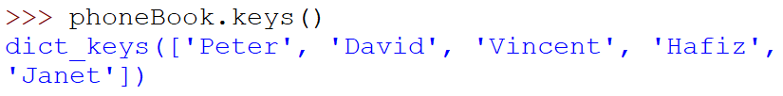


Dictionary Functions
Methods | Description
keys() | Returns a new view of the keys.
values() | Returns a new view of the values.
clear() | Removes all items from the dictionary.
Notes:
If you need the list of keys in the dictionary, use the keys() function. Similarly, the values() function returns the list of values.
Finally, the clear() function removes all items from the dictionary, leaving you with an empty dictionary.

Slide 26
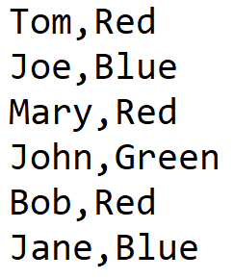
Activity 1 – Invert.py
Create the following text file using Notepad. Save the text file as colors.csv.
Write a Python program to
Read the data from colors.csv and save the name as the key and the color as the value into a dictionary colors_dict.
Invert the dictionary colors_dict to another dictionary new_colors where the keys are values from color_dict and the values are lists of keys from color_dict.
Display new_colors.
Notes:
Let’s end our lesson with a couple of activities. In this first activity, create the given csv file called colors.csv. This is a list of people and their favourite colours.
Once you’ve done that, write a python program to crate a dictionary called colors_dict that contains the names as the key and the favourite colour as the value.
Next, create another dictionary called new_colors which is the inversion of colors_dict. In new_colors, the key is the color, and the value is a list containing all the people who has that color as their favourite color.
Finally, print out new_colors.

Slide 27
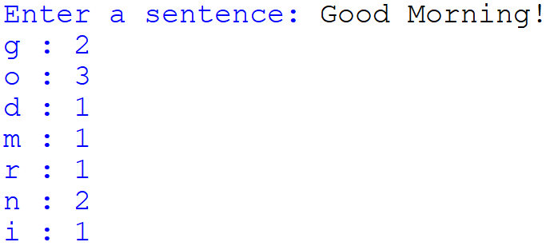
Activity 2 – CountLetters.py
Write a Python program to
Prompt user to input a sentence
Count the occurrence of each letter in the input sentence
Hint: You can use the isalpha() function
Save the result to a dictionary letters where the key is the letter and the value is the occurrence of the key
Display letters in alphabetical order of the key.
Notes:
For the final activity, write a program that prompts the user to enter a sentence. The program then counts the number of occurrences of each letter in the sentence, saving the results in a dictionary called letters. You should only count the alphabets (A to Z), and also handle upper and lowercase letters. Finally, display the number of occurrences of each letter as shown in the example.

Slide 28
Summary
Creating Tuple & Dictionary
Operators and methods for Tuple & Dictionary
Notes:
And we are done. You now have two more useful tools in your programming arsenal. A tuple is more efficient than a list, and is what you should use if the items you are storing will never change. A dictionary is similar to list in that it stored items using an index, but it’s index does not have to be an integer, and the items stored are unordered. For certain applications, a dictionary can be much more convenient than a list.
Congratulations, you have made it through the final lesson in this run of Programming I, and you’ve learned a lot. In the beginning, you might have thought that programming was how it was depicted in the movies, where geeky guys in dark rooms type furiously on the keyboard while neon green text scrolls up the screen. Now, you know that programming is really just coming up with a solution to a problem and telling the computer what you want it to do in a language that it understands. In fact, you now have the ability to write a full-fledged program that receives input, does computations, and reads and writes files, all tied together in a logical algorithm with selection statements, loops and functions.
Yep, I just described what you need to do for your assignment. That’s the final boss you have to defeat. Have fun coding!

